Slide 1



ICU- RERE
ICU- Knowledge triangle, innovation: Reinforcing of
Education, Research E.health & Medical links
Prof. Bassem Kaissi
June 22, 2020

Slide 2
Outline of This Presentation
About ICU- RERE project
ICU - RERE Cornerstones
Consortium
Project WPs
Progress at MUBS

Slide 3
About the ICU- RERE Project
The mission of the ICU- RERE project is to enforce A Knowledge Triangle (AKT) Approach to integrate Education, Research and Community (ERC) to provide timely e.health system focusing on the advances in technology that offer patients, practitioners, medical centers, and hospitals new and innovative options for high quality and cost effective e.medical and healthcare.

Slide 4
ICU - RERE Cornerstones
The major four cornerstones of the ICU-RERE are C A R E:
​
Creating a new relationship between the healthcare sector (Industry), health professional and University (Education & Research) characterized by a true partnership, where decisions are made in a shared manner including training of physicians through online sources (continuing medical education).
Achieve and Enhance high quality E-health may enhance the quality of health care for example by allowing comparisons between different providers, involving patients’ additional power for quality assurance.

Slide 5
Research and evidence based - e-health interventions should be knowledge and evidence-based in a sense that their effectiveness and efficiency should not be assumed but proven by rigorous scientific research and evaluation.
Efficiency - one of the promises of e-health is to increase efficiency in health care, thereby decreasing costs by avoiding duplicative or unnecessary diagnostic or therapeutic interventions.

Slide 6
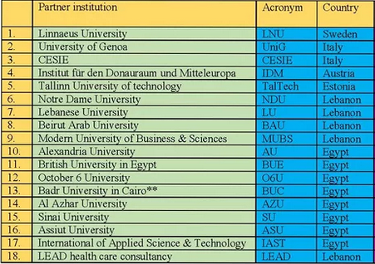
Consortium

Slide 7
Project WPs
WP1: University- Enterprise Centers of E-Health Innovations
WP2: University- Enterprise Web Platform
WP3: Professional Diploma & Master Study Modules
WP4: University- Enterprise In-service Training (IST)
WP5: Capacity Building (CB)
WP6: Dissemination
WP7: Sustainability
WP8: Quality Control (QC)
WP9: Management
+ AZHU

Slide 8
Progress at MUBS
Mrs. Diana Nahle represented MUBS in the “ICU- Knowledge Triangle, Innovation: Reinforcing of Education- Research E-Health and Medical Links” (Erasmus+ project) kick off meeting hosted by October 6 University in Egypt on February 10 and 11, 2020.
Prepared action plan WP5. where Each Enterprise and HEI will participate in a pool of teaching experts through selecting suitable candidates, visits to EU partners & visits by EU professors to Lebanon and Egypt join local training, where up to 4 trainees will attend training programs to improve their web platform and digital skills, training them on innovative Teaching and learning (T&L) methods & assessment methods, utilizing ICT in health education & gain the know-how knowledge necessary to set up the centers & use digital educational portal.
​

Slide 9
Will Support BAU in developing questionnaires for 3 different categories : Stakeholders, Faculty/ Staff, and Students.
Will Collect MUBS data from 3 different categories (Stakeholders, Faculty/ Staff, and Students). The links will be disseminated internally at MUBS once the questionnaires will be approved by the project coordinator

Slide 10
Thank YOU!

