Slide 1
WP7: Sustainability
Meeting: August 23, 2021
Assiut University, Egypt

Slide 2
OUtline
Progress
Plan for the period: (August – December 2021)

Slide 3
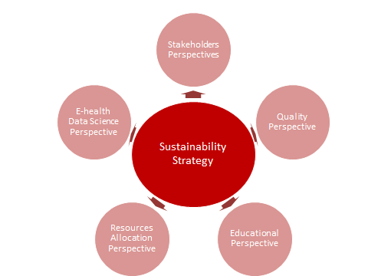
Sustainability Strategy Dimensions

Slide 4
Post COVID-19
E-Ethical Issues
Sustainability Issues
Data Sharing
E1
S

Slide 5
Progress & Executive Plan for WP7 (June–December 2021)
June 2021
October 2021
Start
September 2021
November 2021
31/12/2021
Post-COVID19
Open data E-health related issues
Digital Health Transformation Workshop & Open data initiatives
Deliver
Executed Activities & plan report
Dissemination
Meetings
& report of open data E-health related issues
Data Science and E-Health- related issues

Slide 6
Thank you

